Slide 1

Wit: A Wireless Transfer (Android Version)
Guan Yuqing, Li Qiaochu, Lan Zheng
School of Electronics Engineering and Computer Science
Peking University, Beijing, China

Slide 2
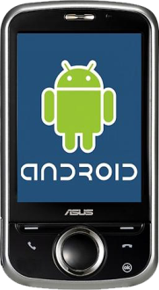



File transmission between mobile devices
If you want to share a file in your cellphone with others, you may try…
Bluetooth?
Weakness: Too slow, too small range, signals decrease rapidly
Google Drive? Microsoft SkyDrive? Dropbox?
Weakness: Slow to visit the server, unable to work when the Internet is unavailable
You need a Wireless LAN-based file sharer! You need WIT!

Slide 3
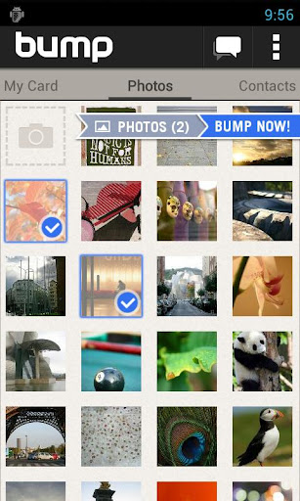
Existing solution: Bump
Bump
Share files simply by “bump”
Lists for photos, contacts and apps
Friendly user interface
Require a connection to the bump server, fatal weakness

Slide 4

Existing solution: IP Messenger
IP Messenger (Flying Pigeon)
Discover other devices by muticast
No need to connect a remote server
Multicast is not supported by many access points
Still require an available Wi-Fi network
Too ugly UI and few features

Slide 5
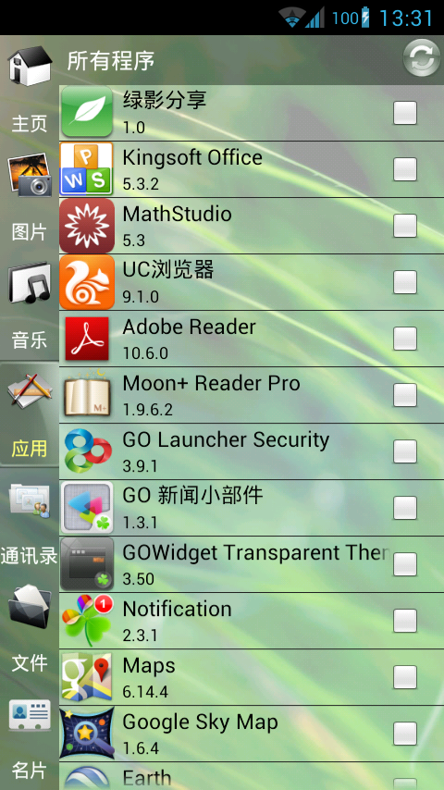
Our solution: Wit
What WIT can do?
Detect and connect users based on Wireless LAN
Transfer files between connected hosts
Encrypt transmitted files with secret keys
Work with and without an available Wi-Fi network
Notes:
The Chinese name of WIT: 绿影分享
The icon of WIT is downloaded from http://www.veryicon.com. It is free for personal non-commercial use, but we are required to provide a link back to the author’s site: http://joshladella005.deviantart.com/.

Slide 6
Detect and connect users based on Wireless LAN
Use “cards” to identify mobile devices in the network
A card includes a unique ID, the username, phone number and host IP
Cards can be exported to the contact list of Android system
Broadcast the local card to all neighbors every 5 seconds
Once a neighbor’s card arrives, update the online list
Mark the newly received card with the current timestamp
Periodically scan the online list, remove timeout cards
When the app exits, broadcast an “unregister” signal
Explicitly tell other hosts to remove it from their online lists
Bob
Alice
ID: XX
Name: Bob
Phone #: XX
IP: XX
ID: XX
Name: Bob
Phone #: XX
IP: XX
ID: YY
Name: Alice
Phone #: YY
IP: YY
ID: XX
Name: Bob
Phone #: XX
IP: XX
ID: XX
Unregister me!
Alice 0
Bob 0
Bob 10
Bob 5
Alice Timeout!
Bob Removed
Notes:
The phone number can be obtained automatically if there is an available number in the SIM card.
The card of local host is sent to the broadcast address instead of a multicast address in case when the gateways do not support multicast.
Broadcast address = (IP address) & (subnet mask) | (~subnet mask)
For example, if the IP address is 192.168.2.102 and the subnet mask is 255.255.255.0, the broadcast address is 192.168.2.255

Slide 7
Detect and connect users based on Wireless LAN
A user can select a card from the online list and send a connection request to the corresponding host
The host on the other side can either accept or decline the request
Once it accepts the request, the host changes its state to “connected”
If the request is accepted, a connection will be established between the two hosts
Two-way handshake
After the establishment of the connection, each host can send a “close” message to the other side and close the connection
Bob
Alice
ID: XX
Close connection
ID: YY
Accept request
ID: XX
Request to connect
ID: YY
Some instructions
ID: XX
Some instructions
Connected to Alice
WIT Connection
Connected
to Bob
Notes:
The IP address of the remote host can be obtained from the online list.
If the connected card is about to be removed from the online list due to a timeout event or an unregister signal, the connection will be closed.

Slide 8
Transfer files between connected hosts
First, the sender sends names of all files to be sent to the receiver
Before sending a file, the sender creates a server socket and binds it to a random port, then sends a file packet to the receiver
A file packet includes the name, type, size of the file, the port number and an MD5 checksum
Once it receives a file packet, the receiver creates a TCP connection to the specified port of the sender to transmit the file
Each file is transmitted through a separate thread scheduled by a thread pool
After the transmission, the receiver checks the integrity of the file and tells the sender whether the file is transferred successfully
Bob
Alice
Data Stream
ID: YY
Receive: AA
Success
ID: XX
Will send: AA
Will send: BB
Will send: CC
ID: XX
Send: AA
File info: 11
Port: 22
MD5: 33
Sending AA
Sending BB
Sending CC
Receiving AA
Receiving BB
Receiving CC
Sending BB
Sending CC
Receiving BB
Receiving CC
TCP Connection
Notes:
A file packet also includes a encrypted DES key which will be mentioned in the next page.
According to the type of the transmitted file, WIT will refresh the media library of Android system or invoke an installation of an APK file when it receives a file successfully.
Both hosts can send to each other simultaneously.

Slide 9


Encrypt transmitted files and secret keys
In case that some bad guys tries to steal the transmitted files, WIT allows its users to send encrypted data
Which cryptography is better?
Symmetric key cryptography: The key is easy to be captured
Public key cryptography: The speed of decryption is EXTREMELY SLOW!
Our solution: Two-level encryption
Use public keys (RSA) to encrypt symmetric keys
Use symmetric keys (AES) to encrypt transmitted files
Trudy
Bob
Alice
Encrypted AES Key
Symmetric Key
Encrypted File A
Data Stream
Symmetric Key
Alice’s Public Key
Alice’s Public Key
Alice’s Public Key
Alice’s Public Key
File A’s AES Key
Alice’s Private Key
File A’s AES Key
Alice’s Private Key
File A’s AES Key
File A’s AES Key
File A’s Content
File A’s AES Key
File A’s Content
File A’s Content
Notes:
Each file packet contains an AES key
Symmetric cryptography can encrypt large chunk of data rapidly
Each card packet contains an RSA public key
Only the card of the local host has the RSA private key
Encryption is optional. Users can enable or disable it in the Settings dialog.

Slide 10

Work without an available Wi-Fi network
Wi-Fi networks are not ubiquitous
Almost all mobile file sharing softwares require an IP address and a reachable network
But users want to share their files and data everywhere, even there is no network
Hotspot / Tethering mode
Android devices can simulate wireless access points in the Hotspot mode
Google hides most APIs of Wi-Fi Hotspot. In order to support the Hotspot mode, we have to read the source code of Android system and invoke some private methods in WifiManager class by the reflection mechanism
Alice’s IP
Bob
Alice
File: A
To: Alice's IP
File: A
To: Alice's IP
File: A
To: ?????
No IP
No IP
No IP
No IP
No IP
Bob’s IP
(Gateway)
Bob’s IP
Alice’s IP
Notes:
If a user wants to share files without any Wi-Fi network, he or she should open the Hotspot mode in the System Settings first

Slide 11
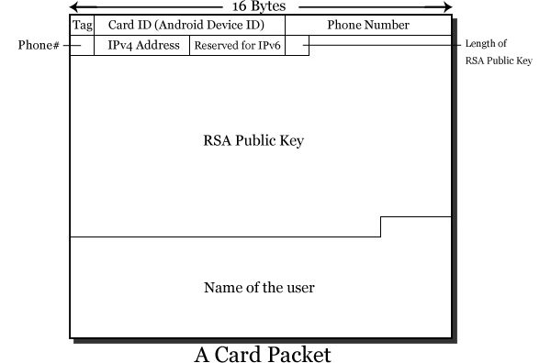
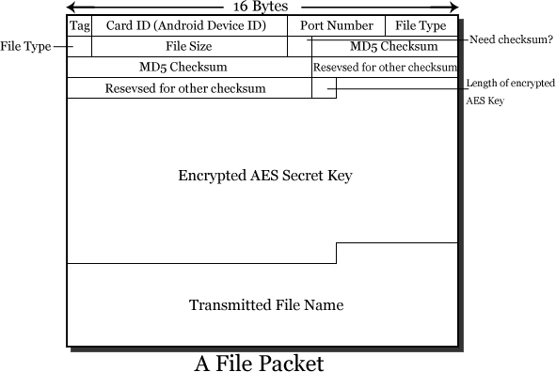
Implementation: Wit Protocols
Card packets are used in
User detection
Host connection
RSA public key transmission
File packets are used in
File transmission
AES key transmission
Card and file packets are transferred via UDP
Files are transferred via TCP

Slide 12
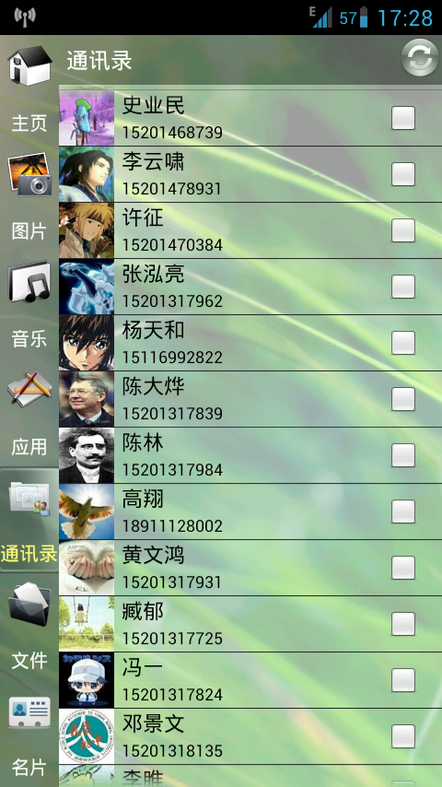
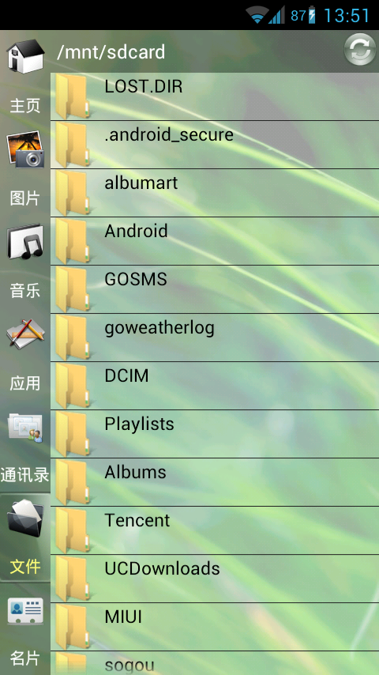
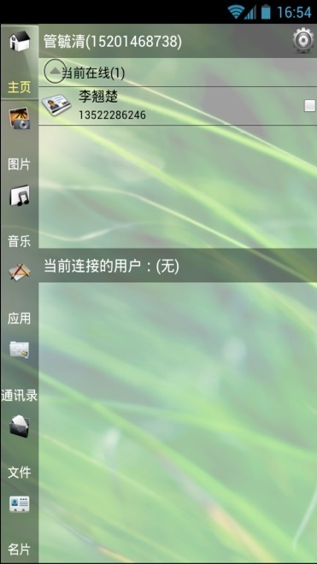
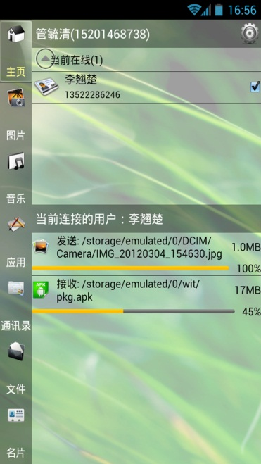
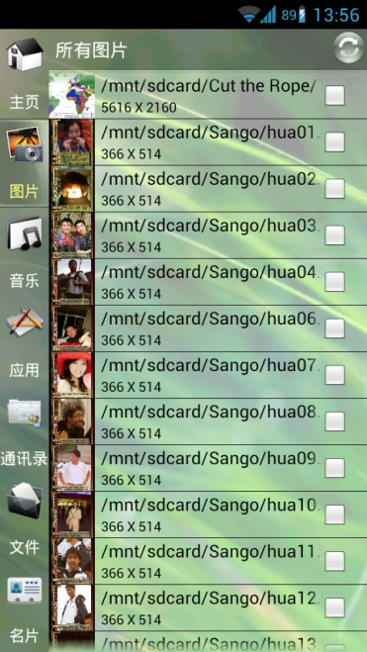
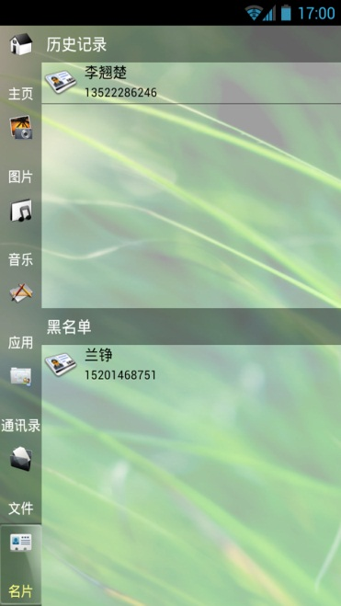
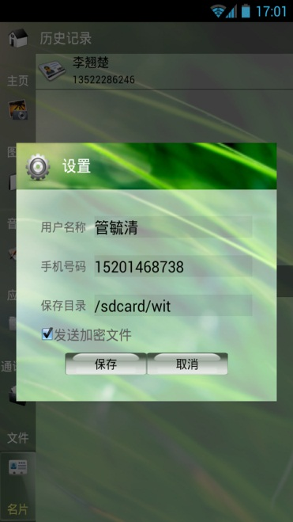
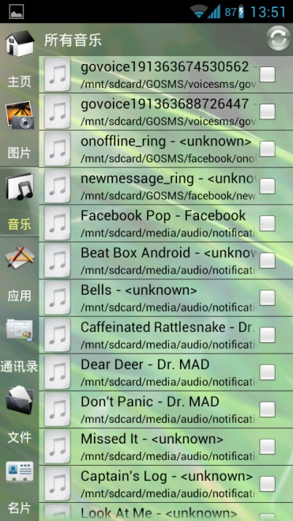

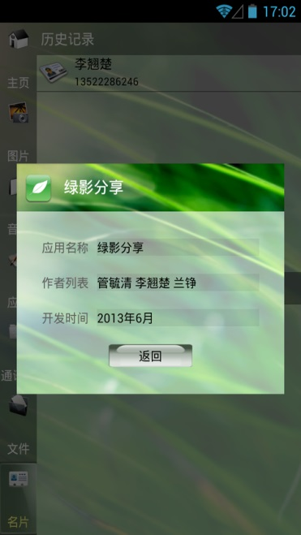
Implementation: Some screenshots
Contact List
File List
Card History
Settings
Card List
Transmission
Photo List
Music List
About
App List
Notes:
Due to the compatible program with Meddle VPN, we take the screenshot in two different mobile devices

Slide 13
Summary
Main functions of WIT
Detect and connect users based on Wireless LAN
Transfer files between connected hosts
Encrypt transmitted files and secret keys
Work with and without an available Wi-Fi network
Other features
Friendly user interface
Lists for ordinary files, photos, audio files, apps and contacts
Auto-refresh the media library or invoke an installation after receiving files of some specific types
Drawbacks
Only suitable for Android platforms
Not support Android systems which versions are lower than 2.3.3
Incompatible with Meddle or other VPN softwares

Slide 14
Our future plan
WIT for iOS?
We are planning to port WIT to the iOS platform
We hope to enable Android and iPhone users to share their files with each other
However, iOS cannot create a Wi-Fi Hotspot, which seriously limits the applicability of WIT
Developing an iOS software requires the programmer to be proficient in Objective-C
We are still discussing our future plan
Our slogan
Let the files fly!

